Slide 1
Crime in Chemistry
Made by: Maria-Anna Boyanova

Slide 2
What is actually a forensic chemist?

Slide 3
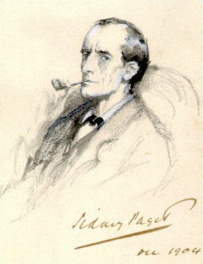
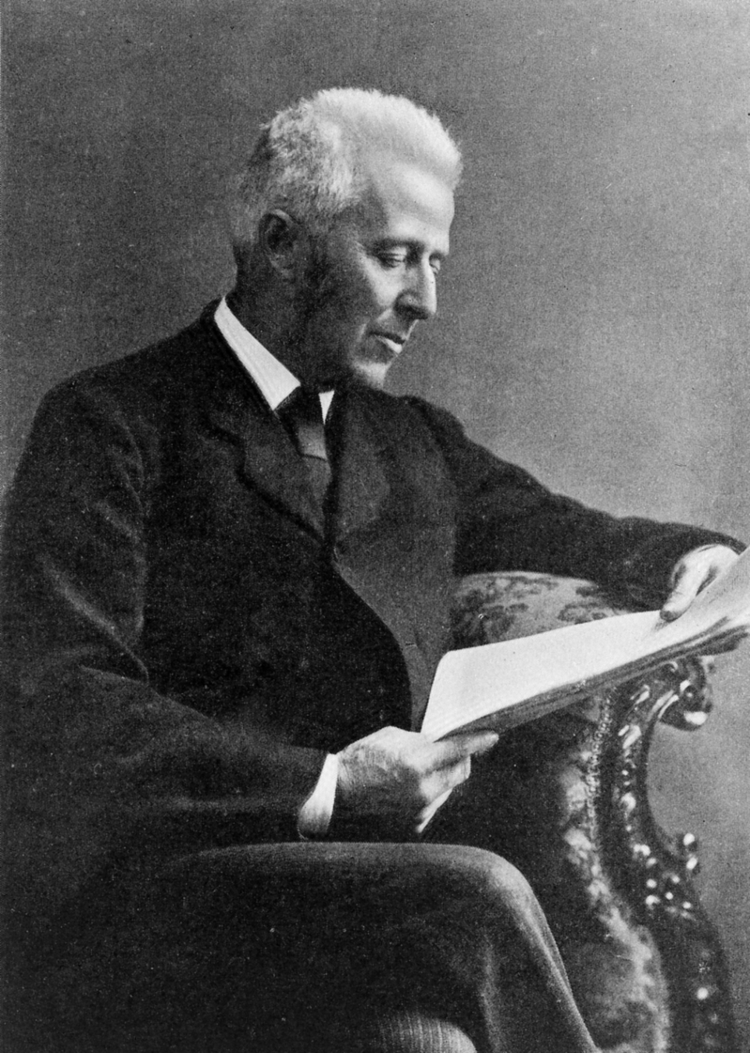
Sherlock Holmes in a 1904 illustration
Dr Joseph Bell

Slide 4
1. Trace evidence
2. Fingerprinting
3. Testing for alcohol
4. Serology
5. Toxicology

Slide 5
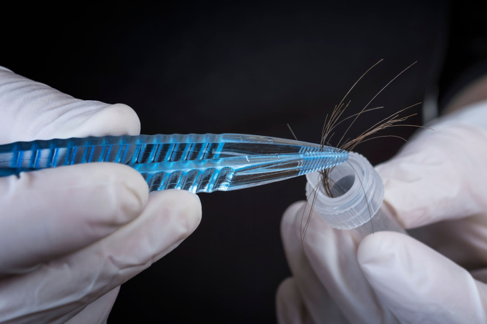
1. Trace evidence

Slide 6
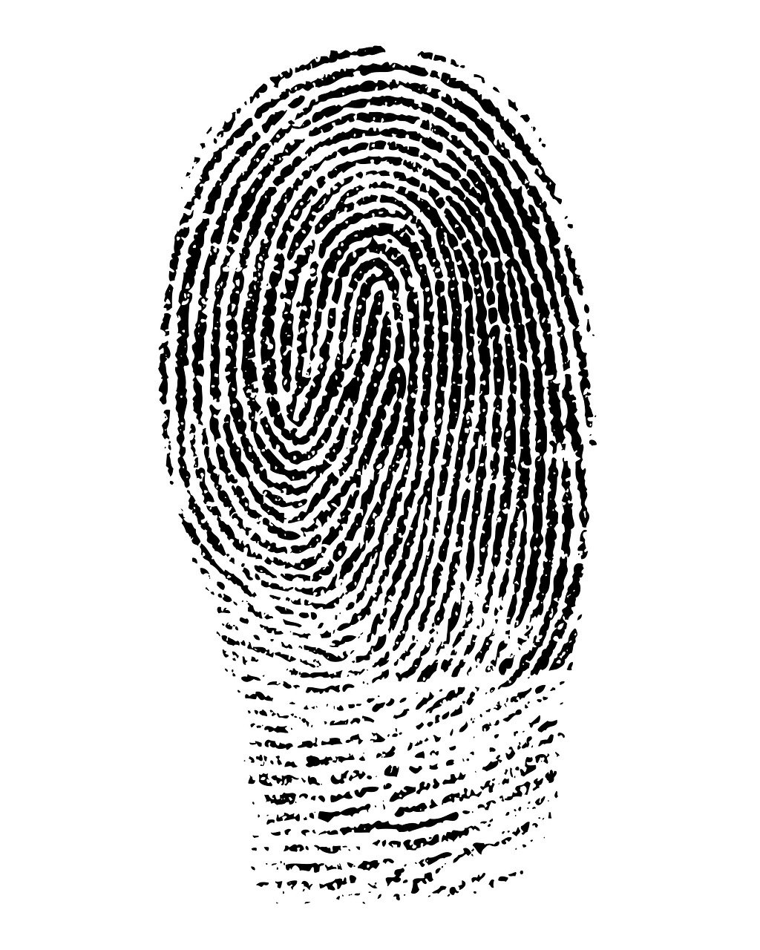
2. Fingerprinting

Slide 7
3. Testing for alcohol

Slide 8
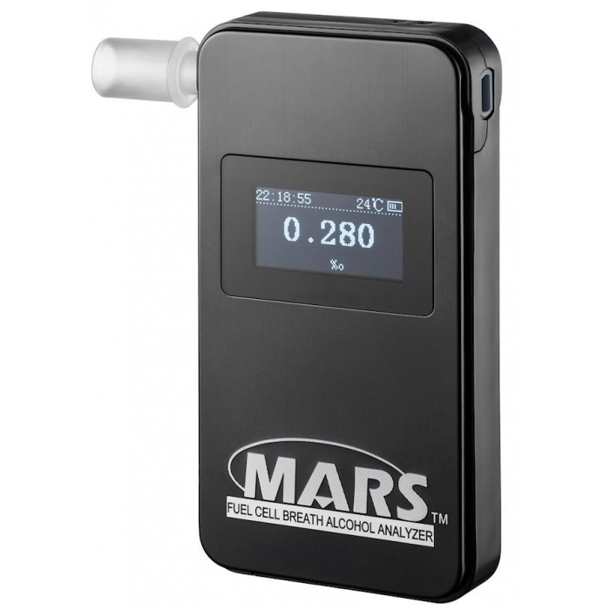
3. Testing for alcohol

Slide 9
3. Testing for alcohol
the number of people who died in car crashes with alcohol-impaired drivers from 2009 to 2018
State | Drunk driving fatalities 2009-2018
Alabama | 2,608
Alaska | 215
Arizona | 2,349
California | 9,288
Colorado | 1,548
Connecticut | 1,080
Florida | 7,573
Georgia | 3,241
Hawaii | 400
Massachusetts | 1,243
Michigan | 2,541

Slide 10
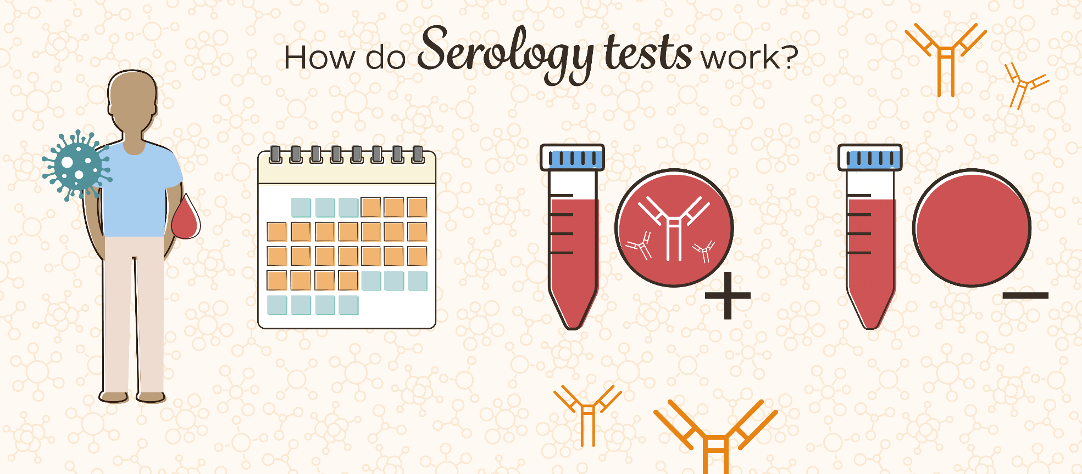
4. Serology

Slide 11
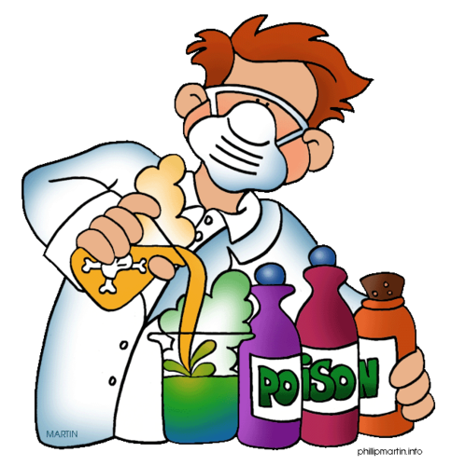
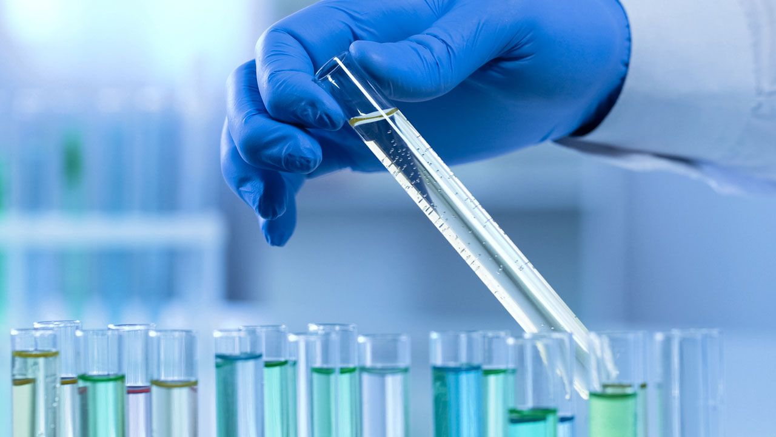
5. Toxicology

Slide 12
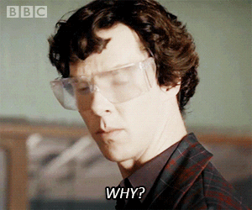

Slide 13
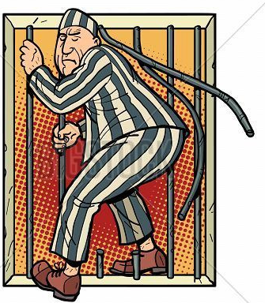

Slide 14
Thank you for your attention!

